Slide 1

Chapter 10 – S14
How to create and use functions
Notes:
Session: Ghi số thứ tự session trong môn học
Session Name: ghi tên của session sẽ dạy

Slide 2
Objectives
Basic for working with functions
The Task Manager application
Notes:
Mô tả nội dung mà học viên phải đạt được khi kết thúc môn học này

Slide 3
Basic skills for working with functions
Notes:
Session: Ghi số thứ tự session trong môn học
Session Name: ghi tên của session sẽ dạy

Slide 4
Functions concepts
Function will help you to divide a program to modules to easier to code and maintain.
Parameters are variables which are used to passed data for function.
All functions return a value. If function is not end by return statement, the function return a value of undefined.

Slide 5
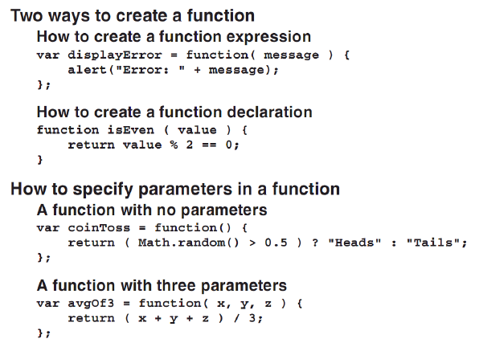
How to create a functions

Slide 6
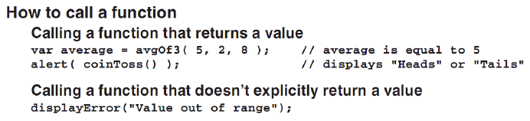
Call a function

Slide 7
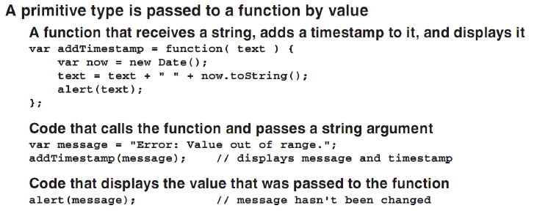
How to passed value to functions

Slide 8
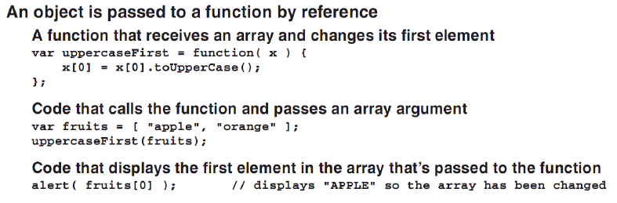
How to passed value to functions -2

Slide 9
How to lexical scope works
Scope in programming language is refers to visibility of variables and functions. It tells you where in your program you are allowed to use the variables and functions that you’ve defined.
Any variable create out side of a function has global scope, and code inside the function can access these global variables.
Any variable create inside of a function has local scope, and code out side of function does’nt have to access these local variables.

Slide 10
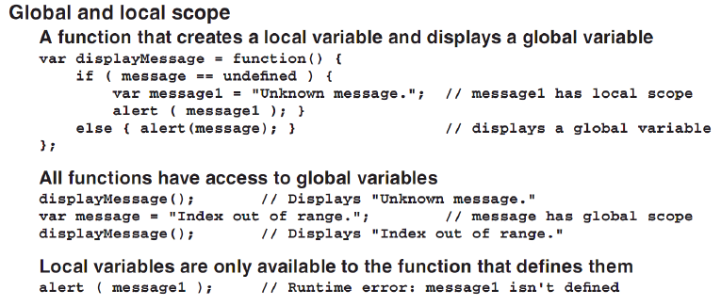
Local and Global scope

Slide 11
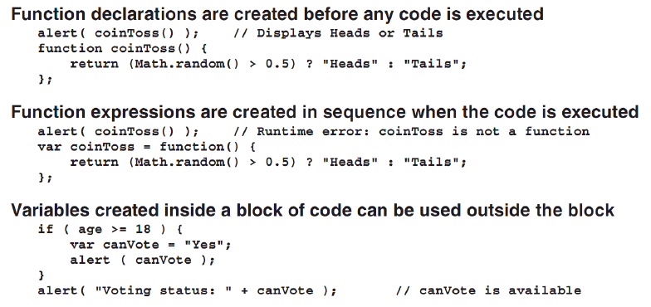
Local and Global scope -2

Slide 12
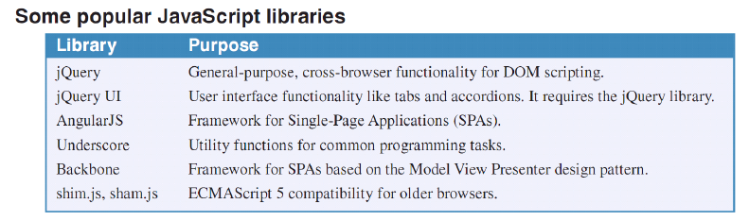
JavaScript libraries
A JavaScript library is an external file that contain related functions, object or both.
JavaScript libraries help you easier to reuse the code of functions.

Slide 13
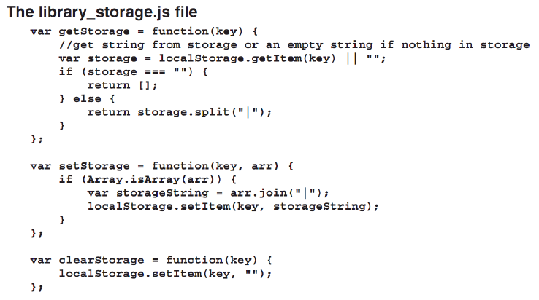
Create a JavaScript Library

Slide 14
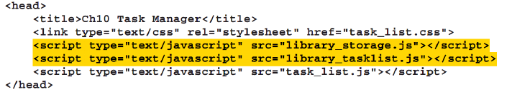
How to use JavaScript Library
Include the libray file to project
Call the function from the library file

Slide 15
The Task Manager application
Notes:
Session: Ghi số thứ tự session trong môn học
Session Name: ghi tên của session sẽ dạy

Slide 16
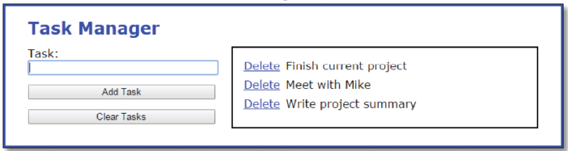
The Task Manager application

Slide 17
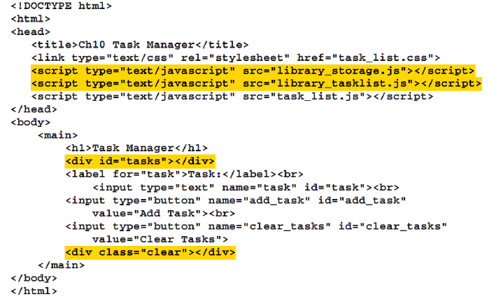
The Task Manager application
HTML code

Slide 18
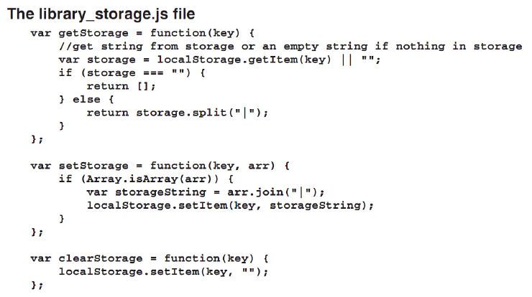
The Task Manager application

Slide 19
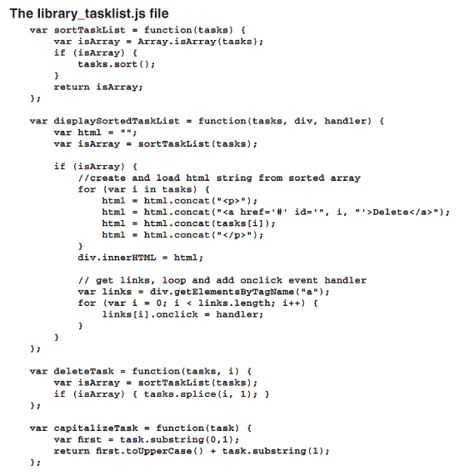

Slide 20
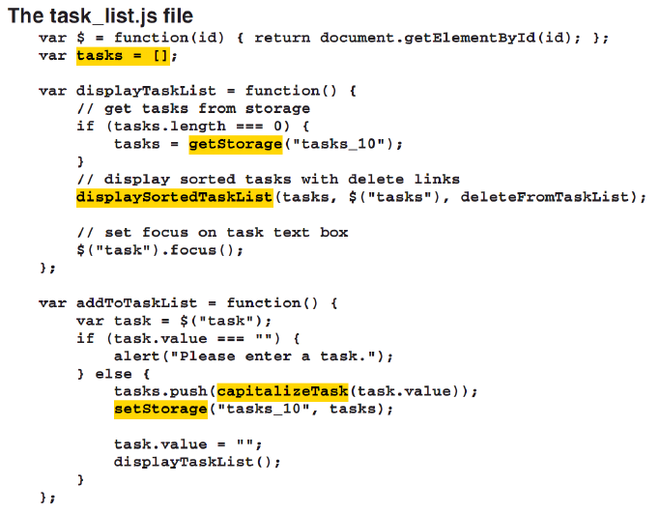
The Task Manager application

Slide 21
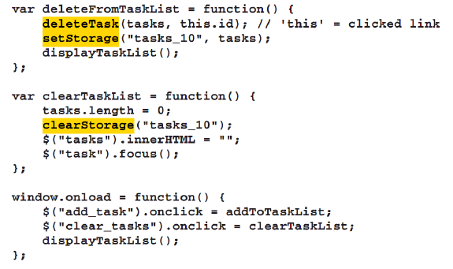
The Task Manager application

Slide 22
Summary
Function will help you to divide a program to modules to easier to code and maintain.
Scope in programming language is refers to visibility of variables and functions. There are global scope and local scope.
A JavaScript library is an external file that contain related functions, object or both.
JavaScript libraries help you easier to reuse the code of functions.
Notes:
Tóm tắt lại nội dung đã học

Slide 23
The End.

